Slide 1
Central Office Appraisal Branch
Presents:
Preparation of a Project Report
Form TC 62-75
Instructors,
Ron Terry & Ron Carrico

Slide 2
Project Report Preparation
What is a Project Report?
Per ROW-903-1 of the Acquisition Manual
A project report is a parcel-by-parcel study of a project. The report is used by Central Office staff to estimate time required for the project.
The report also serves as a control measure of quality and cost of appraisals to be written and services to be provided on the project.

Slide 3
Project Report Preparation
What is the purpose of the project report?
The report is used by KYTC and fee consultants as a guide in preparing bid proposals for various right of way functions.
Along with the plans, cross-sections and a visual inspection, the project report gives the staff an overview description of the potential impacts on the parcels involved.

Slide 4
Project Report Preparation
Preparing the project report
After the final plans are delivered to the district, the ROW Supervisor will assign an experienced agent with a clear understanding of the market condition of the project area to construct the report.
The assigned agent will study the plans and cross-sections and do a visual inspection to see that all of the pertinent information is consistent with the information on the plans.

Slide 5
Project Report Preparation
Preparing the project report cont.
During the visual inspection, the agent will note any changes to the parcels since the plans were created.
Once the agent is confident that all reasonable impacts on the subject project were considered, an itemized list of impacts should be tallied and recorded on form TC 62-75, pages 1 & 2.

Slide 6
Project Report Preparation
TC 62-75
Page one consists of the project information in the header and is simply a summary of the total numbers of the requested information. i.e. number of partial/total takes, vacant/improved parcels, etc.
Page two is designed to itemize the parcels that the agent recognized during their study of the project.

Slide 7
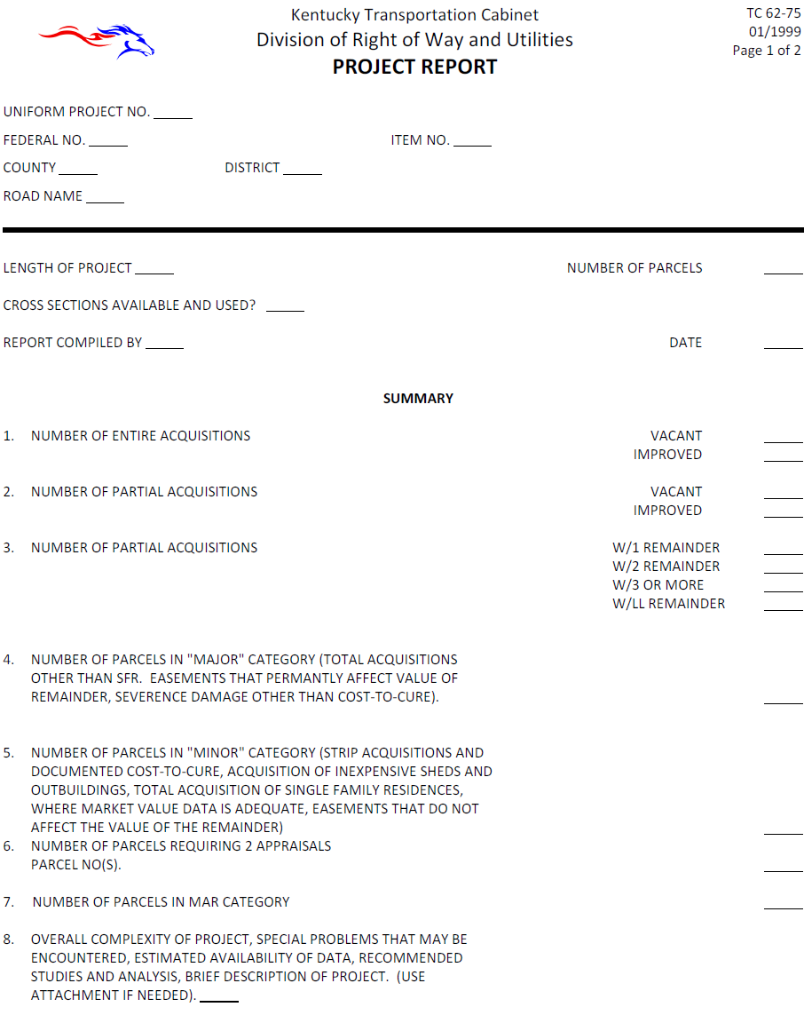

Slide 8
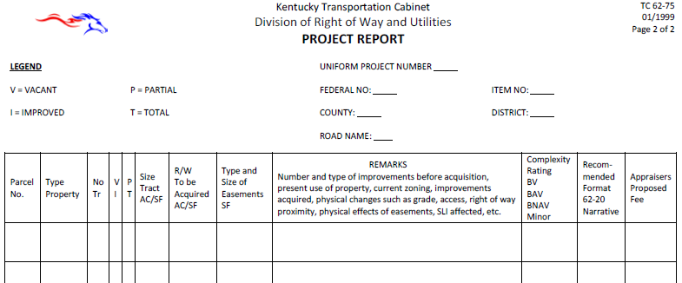

Slide 9
Project Report Preparation
TC 62-75, page two
The first eight columns are self explanatory. However, special attention should be observed under the property type column because it may not be clear or potentially transitional.
The Remarks column is the body of the report and should contain sufficient information to give a thorough understanding of the appraisal problem.

Slide 10
Project Report Preparation
TC 62-75, page 2 cont.
Refrain from stating any form of damages as fact since this determination shall be made by the appraiser responsible for writing the appraisal.
However, details describing the depth of the take, approximate distances to improvements or any other noticeable affects will be helpful for the Appraiser’s consideration.

Slide 11
Project Report Preparation
TC 62-75, page 2 cont.
The Complexity Rating column list three options.
BV (Before Value): This rating is used when there is no after value, i.e. total acquisition.
BAV (Before and After Value): This rating is used on a partial acquisition which presents a complex appraisal problem.
MINOR: This rating maybe used for either a partial or a total acquisition.

Slide 12
Project Report Preparation
TC 62-75, page 2 cont.
The column Recommended Format instructs the appraiser to complete the appraisal using the RWUMS form format or to complete it a Narrative report with sheet 16 and upload it into the RWUMS system for review.

Slide 13
Project Report Preparation
Impacts that the writer should acknowledge
Proximity damage
Cut and Fills
Is septic system impacted?
Are Site Improvements impacted?
Will project potentially change H&B Use?
Over improvement on remainder.
TE or PE potential damage
Loss of parking

Slide 14
Project Report Preparation
Quiz
In your table groups, review the plans and strip map for parcel 21 and prepare to discuss any potential impacts that you recognize as noteworthy.

Slide 15
Project Report Preparation
What impacts did you Note?
Additional parking area
Septic lines taken
Proximity of proposed take to house
Heath Dept. site evaluation for septic replacement
Possible uneconomic remnant if septic cannot be replaced.

Slide 16
Project Report Preparation
Questions or Comments?

Slide 17
Thank You

